Slide 1
MVC Pattern

Slide 2
What is MVP?
The Model-View-Presenter design pattern is a modern pattern to separate the view from the underlying model. MVP is a derivative of the model–view–controller (MVC) software pattern, also used mostly for building user interfaces.

Slide 3
Continued
The model is the data that will be displayed in the view (user interface).
The view is an interface that displays data (the model) and routes user commands (events) to the presenter to act upon that data. The view usually has a reference to its presenter.
The presenter is the “middle-man” and has references to both, view and model. Presenter handles all the business logic that retrieves or manipulates a Model. For instance: If you have a database with User and your View wants to display a list of User, then the Presenter would have a reference to your database business logic (like a DAO) from where the presenter will query a list of Users.

Slide 4
More on MVP
Separating the presentation of the application’s UI from the logic of its UI is usually a good idea. This separation of concerns creates more de-coupled code, which is much cleaner, and even allows for more unit testing coverage. Android bundles the UI and UI logic into the Activity class, which necessitates Instrumentation to test the Activity. Since Instrumentation is introduced, it is much more difficult (or impossible) to properly unit test your UI logic when the dependencies in the code cannot be mocked. However, a simple MVP pattern will help de-couple the UI and UI logic in Android applications.

Slide 5
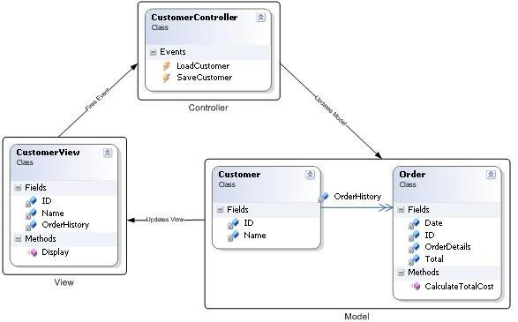
MVC Diagram

Slide 6
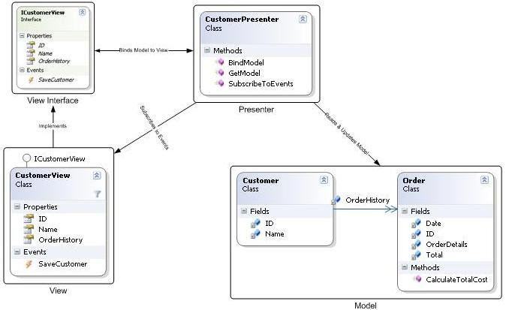
MVP Diagram

Slide 7
MVP vs MVC
MVP Pattern
View is more loosely coupled to the model. The presenter is responsible for binding the model to the view.
Easier to unit test because interaction with the view is through an interface
Usually view to presenter map one to one. Complex views may have multi presenters.
MVC Pattern
Controller are based on behaviors and can be shared across views
Can be responsible for determining which view to display

Slide 8
MVP Advantages
Loose coupling
Clear separation of concerns/responsibility
Test Driven
Code
Hide Data
Flexibility/Adaptable

Slide 9
Refernces
http://antonioleiva.com/mvp-android/
http://www.infragistics.com/community/blogs/todd_snyder/archive/2007/10/17/mvc-or-mvp-pattern-whats-the-difference.aspx
http://magenic.com/Blog/Post/6/An-MVP-Pattern-for-Android
https://vaadin.com/web/magi/home/-/blogs/model-view-presenter-pattern-with-vaadin
https://github.com/sockeqwe/Vaadin-MVP-Lite/wiki/Model-View-Presenter:-The-Basics
Other MVP code examples
https://github.com/antoniolg/androidmvp
https://github.com/android10/Android-CleanArchitecture/tree/master/presentation

